Slide 1
APACHE SparK VISUALIZATION USING PYSPARK
MUHAMMAD NIDZAM BIN MASOOD
MAN171043

Slide 2
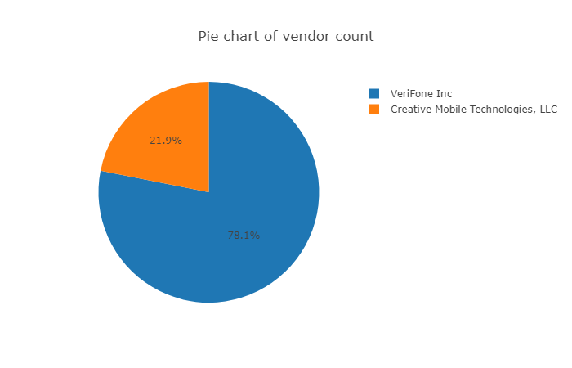
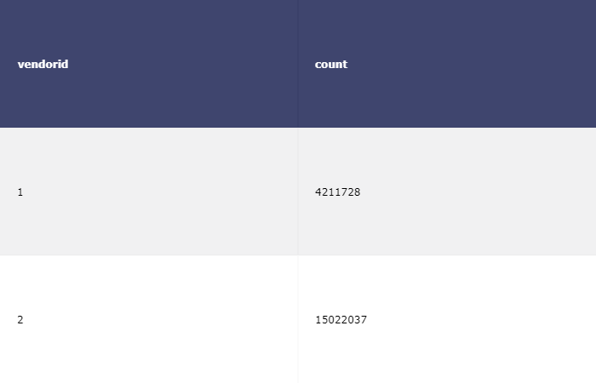
Data vendor analysis

Slide 3
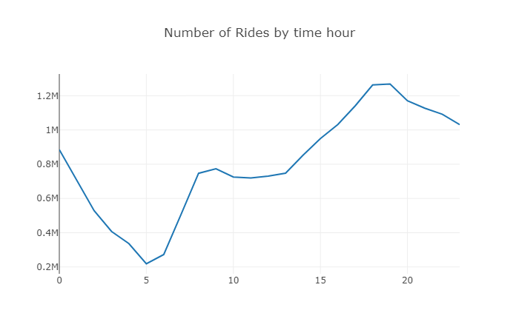
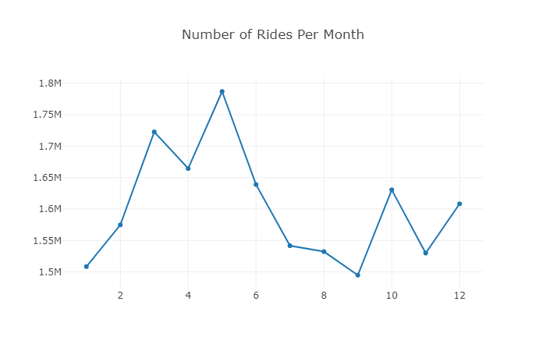
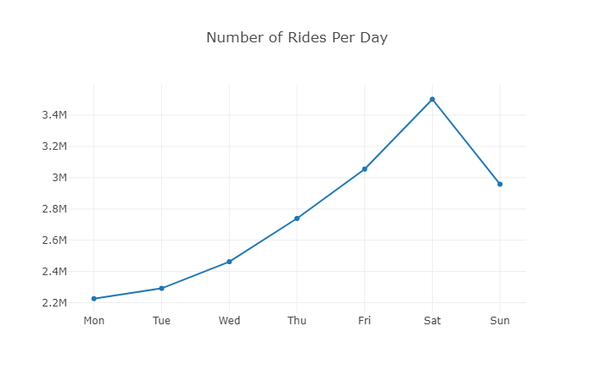
Ride count analysis

Slide 4
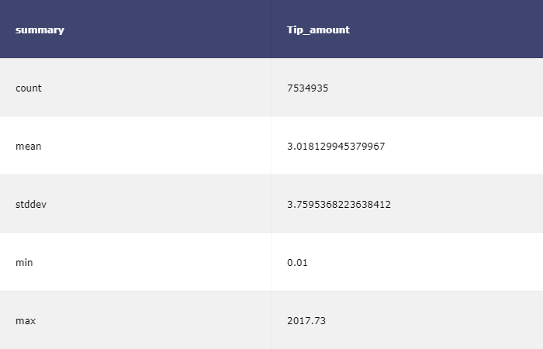
Tips AMOUNT analysis

Slide 5
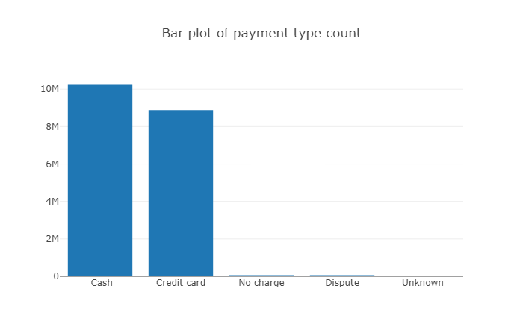
Payment type analysis

Slide 6
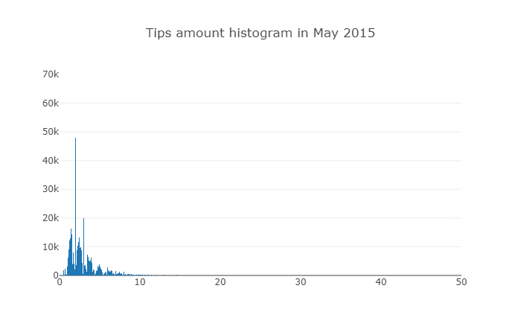
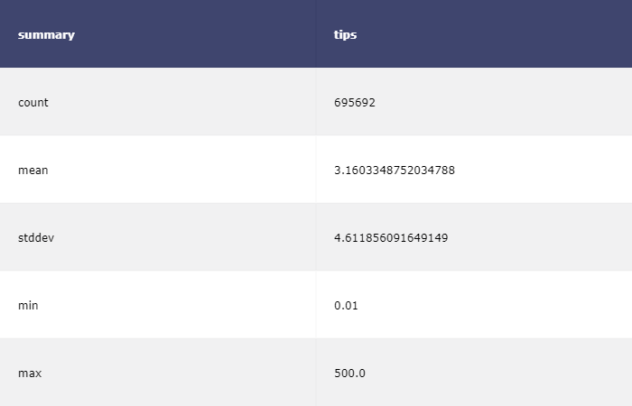
Tips AMAUNT analysis for May 2015

Slide 7
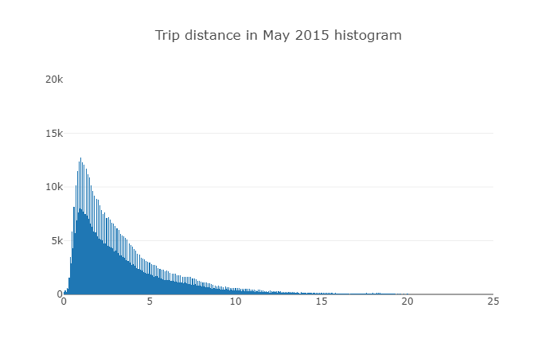
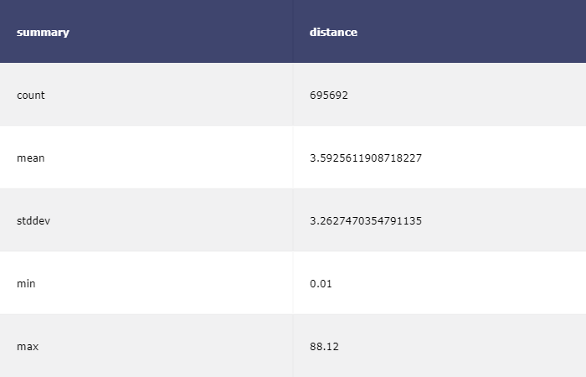
Trip distance analysis for May 2015

Slide 8
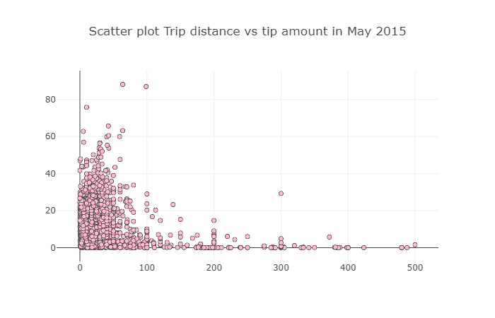
Trip distance and tips amount analysis for May 2015

